Slide 1
Introduction to computational thinking MS1008
The Hands-on Mini Project

Slide 2
The hands-on mini project
Choose one of the four problems below to work on:
P1: Fibonnaci series (easy).
P2: Equation solver (somewhat difficult).
P3: Gregorian calendar (somewhat difficult).
P4: Maze walk (difficult)
Marking will be based upon the success and the difficulty level of your chosen project as well as individual participation.
The assessment will be in Week 13 (time to be announced):
Each group will be given around 20 mins to present your work, and asked to submit the final python code.
Every group member has to participate in the assessment
Each person has to present his /her part ... each 2-3 mins... followed by Q&A.

Slide 3
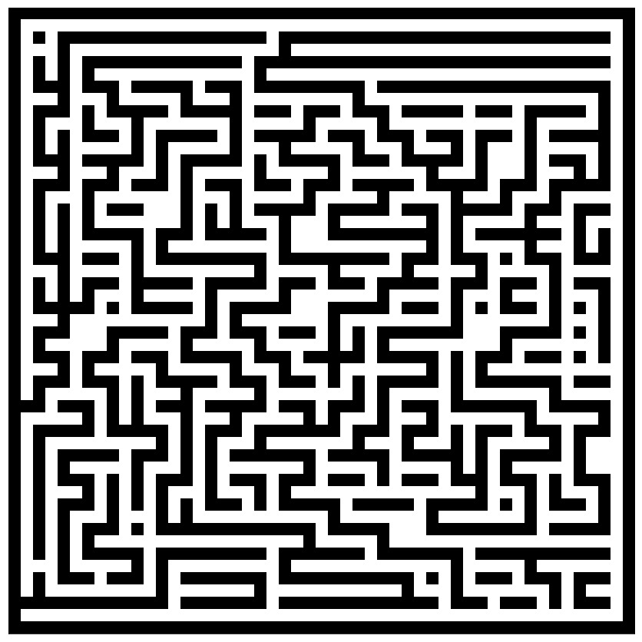
Problem 4
Write a python program that finds a way to walk from a given point (to be announced in assessment (input code)) to the red dot at the lower left corner of the maze below (use “import matplotlib.pyplot as plt” for plotting).
The maze can be read out from attached maze.txt (use eval(‘True’) to convert).

